Slide 1
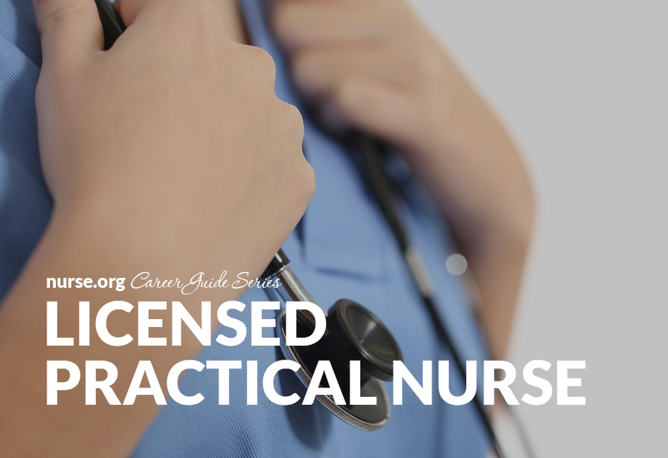
Notes:
A licensed practical nurse in the US and Canada; are the nurses who are responsible for the sick or those who are disabled in the country working under the guidance of the registered nurse's organization.

Slide 2
Responsibilities
The are hired to provide medical health services
They act as medical consultants on the medical matters
Monitor patients
Make patients comfortable
Provide basic care
Listen to patients
Report to the doctors about the patient’s condition
Maintain and keep records
Notes:
Licensed practical nurse, they should be trained so that to acquire some skills for performing their duties effectively.

Slide 3
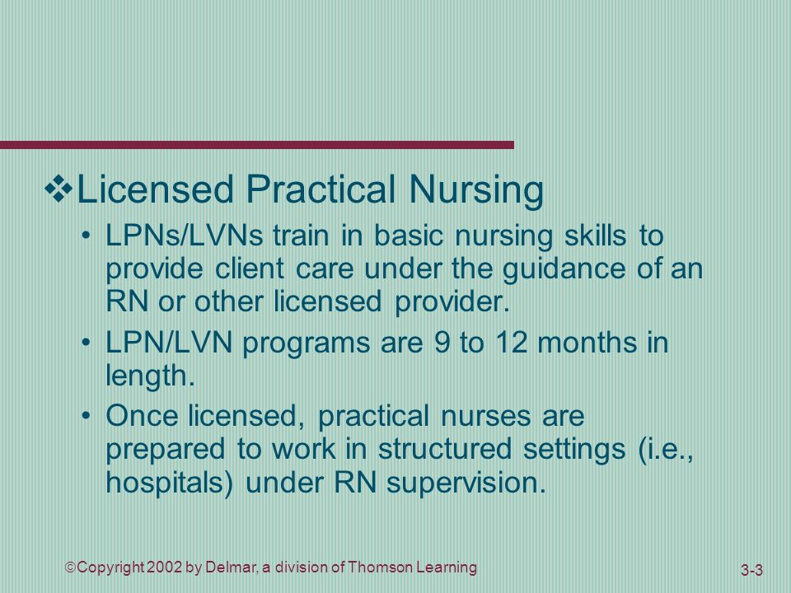
Notes:
Nursing Education and Research Fundamentals of Nursing

Slide 4
The body of accreditation
Accreditation certificates from the collages and health centers to show you can carry out your duties effectively.
Certification includes patient counseling certification, IV certification and others that can be provided from the hospitals or community health services in the United States.
Notes:
The National Council of State Boards of Nursing is a body that is situated in the US that is not profit-oriented and its members come from the 50 states.

Slide 5
The body of accreditation
National Council of State Boards Nursing
The body offers test exams after completing the accreditation program
State Body of Nursing provides the licenses
Notes:
The main objective of this body is to enable the board of nursing to act to look at the matter and well-being of the nurses like safety, health, and welfare.

Slide 6
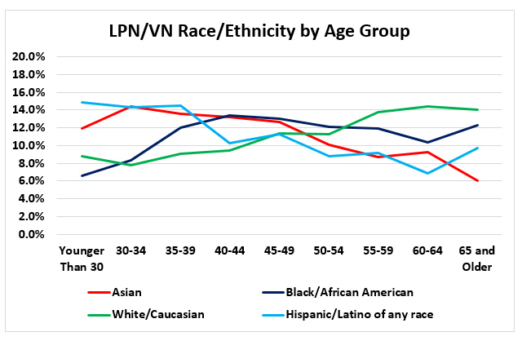
Notes:
National Nursing Workforce Study
National Nursing Workforce Study
National Nursing Workforce Study

Slide 7
Education
The requirements finished basic education with certification that is primary and high school education
Must complete certificate or diploma education of licensed practical nurse which takes one to two years at technical schools or colleges
Certification is done through an exam that is done through the National Council Licensure Examination.
Notes:
GED or High school diploma, and being graduated from an accredited LPN program are the key qualifications for one to become an LPN. The programs are most dwell in coursework and field practical application of the skill specifically in the hospital.

Slide 8

Notes:
How to Become an LPN: Licensed Practical Nurse Education & Licensing

Slide 9
Work requirements
Licensed practical nurses work in hospitals and are surrounded by different health care practitioners such as doctors and registered nurses, they work in homes, assisted living facilities, health clinics, private physician practices. Most of the day they stand for easy delivery of services, they help to lift or move patients.
They can advance their careers to become specialists in various areas, psychiatric nurses, orthopedic nurses, information nurses, burn nurse and hospice nurses.
Notes:
GED or High school diploma, and being graduated from an accredited LPN program are the key qualifications for one to become an LPN. The programs are most dwell in coursework and field practical application of the skill specifically in the hospital

Slide 10
Employment and salary
There is a high demand for L P N careers in the U.S, there is a shortage of nurses in the U.S, as the population rises they are needed and will be needed in health facilities, at homes to take care of patients at home.
The employment of L P N is anticipated by the U.S government to rise because of the number of patients who want to be treated at home.
Notes:
There is no great competition with other careers since there must be an LP N in any health facility. Varies industries provide nursing jobs such as nursing care facilities, home health care facilities, community care facilities and hospitals and it is easy to improve your career.
They receive a good salary as from 26, 590 dollars to 68, 450 dollars

Slide 11
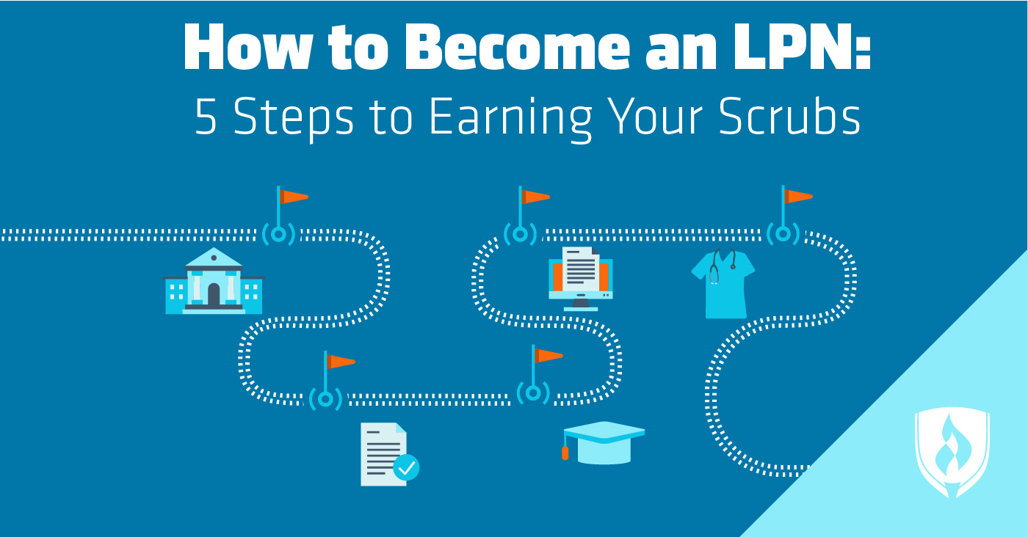
Notes:
How to become an LPN; Choose a nursing school, Sit for the TEAS exam, Complete your nursing program, Sit for the NCLEX exam and Find a job

Slide 12
Current trends of influence
A high number of nurses are needed in the health industry due to the rising population, the hospitals need LPN, patients at home need their services, community health facilities need their services, it is one of the common profession that is valued by people in the medical services and it is easy to get employment.
Notes:
The high number of the aging population, nursing shortage, and an overarching emphasis on specific frameworks for the guiding of nursing practice like the integration of evidence-based practice is the current trend in nursing.

Slide 13
Professionalism
Apart from education, it requires these skills
Compassion, they must be caring to take care of the patients
Patience, the patient depending on the illness can be sometimes outrageous but the nurse has to control the situation.
They must have the stamina to keep themselves feet for the whole day during working hours
Notes:
In addition they need to communicate well with their patients and also they should be detailed oriented to help the patients know their illness and how to treat them.

Slide 14
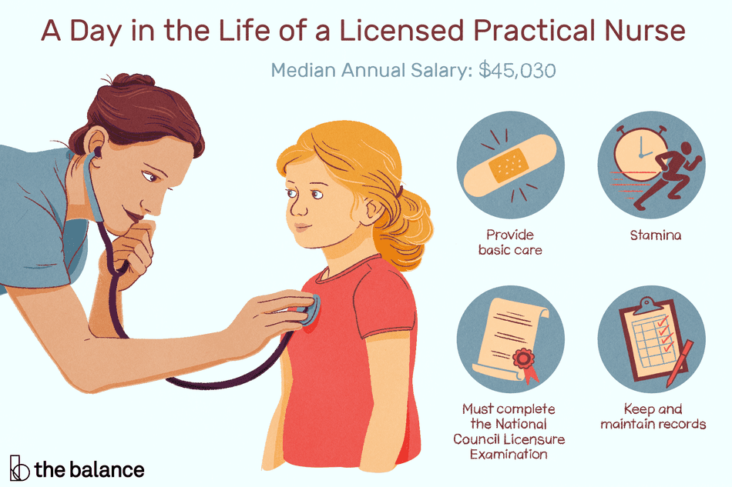
Notes:
Chart showing the responsibilities of the Licensed Practical Nurse

Slide 15
References
Cook, L., Dover, C., Dickson, M., & Engh, B. (2010). Returning to school: The challenges of the licensed practical nurse-to-registered nurse transition student. Teaching and Learning in Nursing, 5(3), 125-128.
Morris, A. H., & Faulk, D. R. (2012). Transformative learning in nursing: A guide for nurse educators. Springer Publishing Company.
MSc, P. B. (1987). Towards an epistemological basis for experiential learning in nurse education. Journal of Advanced Nursing, 12(2), 189-193.
Notes:
References

Slide 16
References
Öhrling, K., & Hallberg, I. R. (2000). Student nurses' lived experience of preceptorship. Part 1—in relation to learning. International Journal of Nursing Studies, 37(1), 13-23.
Papp, I., Markkanen, M., & von Bonsdorff, M. (2003). Clinical environment as a learning environment: student nurses’ perceptions concerning clinical learning experiences. Nurse education today, 23(4), 262-268.
Saarikoski, M., & Leino-Kilpi, H. (2002). The clinical learning environment and supervision by staff nurses: developing the instrument. International journal of nursing studies, 39(3), 259-267.
Notes:
References

